Slide 1
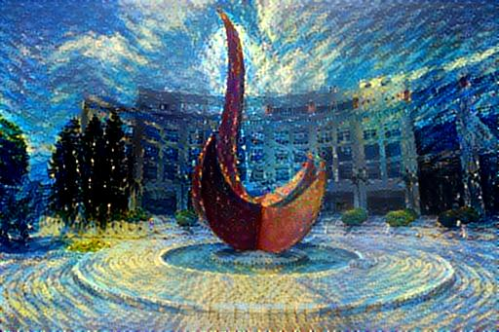
Recurrent Neural Networks (RNN), Long-Short-Term-Memory (LSTM), Attention and Transformer
Yuan YAO
HKUST

Slide 2
Summary
We have shown:
CNN Architectures: LeNet5, Alexnet, VGG, GoogleNet, Resnet
Today:
Recurrent Neural Networks
LSTM/GRU
Attention
Transformer
Reference:
Feifei Li, Stanford cs231n
Chris Manning, Stanford cs224n

Slide 3
Recurrent Neural Networks

Slide 4
Recurrent Neural Networks: Process Sequences
Image Captioning
Vanilla Neural Network
Machine Translation, Dialogue
Sentiment Classification
Video frame-based classification/annotation

Slide 10
Vanilla Recurrent Neural Networks
State Space equations in feedback dynamical systems
Or,

Slide 11
Linear Dynamical Systems (1940s-)
time →
The hidden state has linear dynamics with Gaussian noise and produces the observations using a linear model with Gaussian noise.
Kalman Filter: A linearly transformed Gaussian is a Gaussian. So the distribution over the hidden state given the data so far is Gaussian. It can be computed using “Kalman filtering”.
To predict the next output (so that we can shoot down the missile) we need to infer the hidden state.
output
output
output
hidden
hidden
hidden
driving input
driving input
driving input

Slide 12
Hidden Markov Models (1970s-)
Hidden Markov Models have a discrete one-of-N hidden state. Transitions between states are stochastic and controlled by a transition matrix. The outputs produced by a state are stochastic.
We cannot be sure which state produced a given output. So the state is “hidden”.
It is easy to represent a probability distribution across N states with N numbers.
To predict the next output we need to infer the probability distribution over hidden states.
HMMs have efficient algorithms (Baum-Welch or EM Algorithm) for inference and learning.
Jim Simons hires Lenny Baum as the founding member of Renaissance Technologies in 1979
output
output
output
time →

Slide 13
Recurrent Neural Networks
The issue of a hidden Markov model (HMM):
At each time step it must select one of its hidden states. So with N hidden states it can only remember log(N) bits about what it generated so far.
RNNs are very powerful, because they combine two properties:
Distributed hidden state that allows them to store a lot of information about the past efficiently.
Non-linear dynamics that allows them to update their hidden state in complicated ways.
With enough neurons and time, RNNs can compute anything that can be computed by your computer.

Slide 15
Time invariant systems

Slide 16
Outputs added

Slide 17
Loss modules

Slide 32
Example: Text->RNN
https://gist.github.com/karpathy/d4dee566867f8291f086

Slide 42
Popular Architectures

Slide 44
RNN

Slide 52
The Fundamental Deep Learning Problem: Vanishing / Exploding Gradients

Slide 59
Long Short Term Memory (LSTM)

Slide 60
Long-Short-Term-Memory (LSTM)
A type of RNN proposed by Hochreiter and Schmidhuber in 1997 as a solution to the vanishing gradients problem.
“Long short-term memory”, Hochreiter and Schmidhuber, Neural Computation, 9(8):1735-1780, 1997. Link: https://www.bioinf.jku.at/publications/older/2604.pdf
On time step t, there is a hidden state h and a cell state c
Both are vectors length n
The cell stores long-term information
The LSTM can erase, write and read information from the cell
The selection of which information is erased/written/read is controlled by three corresponding gates
The gates are also vectors length n
On each time step, each element of the gates can be open (1), closed (0),
or somewhere in-between.
The gates are dynamic: their value is computed based on the current context

Slide 61
Long-Short-Term-Memory (LSTM)

Slide 62
LSTM Flowchart
Source: http://colah.github.io/posts/2015-08-Understanding-LSTMs/

Slide 65
Gated Recurrent Unit (GRU)

Slide 66
Gated Recurrent Unit: tanh RNN
(tanh) RNN is expensive in exploiting the whole register

Slide 67
Gated Recurrent Unit (GRU)
GRU is much more economic for computation!

Slide 68
GRU
"Learning Phrase Representations using RNN Encoder–Decoder for Statistical Machine Translation", Cho et al. 2014, https://arxiv.org/pdf/1406.1078v3.pdf

Slide 69
GRU and LSTM

Slide 70
LSTM vs. GRU
Researchers have proposed many gated RNN variants, but LSTM and GRU are the most widely-used
The biggest difference is that GRU is quicker to compute and has fewer parameters
There is no conclusive evidence that one consistently performs better than the other
LSTM is a good default choice (especially if your data has particularly long dependencies, or you have lots of training data)
Rule of thumb: start with LSTM, but switch to GRU if you want something more efficient

Slide 71
Is vanishing/exploding gradient just a RNN problem?
No! It can be a problem for all neural architectures (including feed-forward and convolutional), especially deep ones.
Due to chain rule / choice of nonlinearity function, gradient can become vanishingly small as it backpropagates
Thus early layers are learnt very slowly (hard to train)
Solution: lots of new deep feedforward/convolutional architectures that add more direct connections (thus allowing the gradient to flow)
For example:
“HighwayNet” with highway connections:
Similar to residual connections, but the identity connection vs the transformation layer is controlled by a dynamic gate
Inspired by LSTMs, but applied to deep feedforward/convolutional networks
ResNet with residual connections, inspired by HighwayNet
DenseNet directly connect everything to everything!

Slide 72
Summary
RNN is flexible in architectures
Vanilla RNNs are simple but don’t work very well
Common to use LSTM or GRU: their additive interactions improve gradient flow
Backward flow of gradients in RNN can explode or vanish.
Exploding is controlled with gradient clipping.
Vanishing is controlled with additive interactions

Slide 73
Some Historical Remarks on LSTM
[LSTM0] S. Hochreiter and J. Schmidhuber. Long Short-Term Memory. TR FKI-207-95, TUM, August 1995. Link: https://people.idsia.ch/~juergen/FKI-207-95ocr.pdf
[LSTM1] S. Hochreiter, J. Schmidhuber. Long Short-Term Memory. Neural Computation, 9(8):1735-1780, 1997. Based on [LSTM0].
[LSTM2] F. A. Gers, J. Schmidhuber, F. Cummins. Learning to Forget: Continual Prediction with LSTM. Neural Computation, 12(10):2451-2471, 2000. The "vanilla LSTM architecture" with forget gates that everybody is using today, e.g., in Google's Tensorflow.
[LSTM3] A. Graves, J. Schmidhuber. Framewise phoneme classification with bidirectional LSTM and other neural network architectures. Neural Networks, 18:5-6, pp. 602-610, 2005.
Schmidhuber: “In 2020 we celebrated the quarter-century anniversary of LSTM's first failure to pass peer review. After the main peer-reviewed publication in 1997^{[LSTM1]} (now the most cited article in the history of Neural Computation), LSTM and its training procedures were further improved on my Swiss LSTM grants at IDSIA through the work of my later students Felix Gers, Alex Graves, and others. A milestone was the "vanilla LSTM architecture" with forget gate^{[LSTM2]}—the LSTM variant of 1999-2000 that everybody is using today, e.g., in Google's Tensorflow. 2005 saw the first publication of LSTM with full backpropagation through time and of bi-directional LSTM^{[LSTM3]} (now widely used).”

Slide 74

Some Historical Remarks on HighwayNet
[HW1] R. K. Srivastava, K. Greff, J. Schmidhuber. Highway networks. Preprints arXiv:1505.00387 (May 2015) and arXiv:1507.06228 (July 2015). Also at NIPS 2015. The first working very deep feedforward nets with over 100 layers (previous NNs had at most a few tens of layers). Let g, t, h, denote non-linear differentiable functions. Each non-input layer of a highway net computes g(x)x + t(x)h(x), where x is the data from the previous layer. (Like LSTM with forget gates^{[LSTM2]} for RNNs.) Resnets^{[HW2]} are a special case of this where the gates are always open: g(x)=t(x)=const=1. Highway Nets perform roughly as well as ResNets^{[HW2]} on ImageNet.^{[HW3]} Highway layers are also often used for natural language processing, where the simpler residual layers do not work as well.^{[HW3]}
[HW2] He, K., Zhang, X., Ren, S., Sun, J. Deep residual learning for image recognition. Preprint arXiv:1512.03385 (Dec 2015). Residual nets are a special case of Highway Nets^{[HW1]} where the gates are always open: g(x)=1 (a typical highway net initialization) and t(x)=1.
[HW3] K. Greff, R. K. Srivastava, J. Schmidhuber. Highway and Residual Networks learn Unrolled Iterative Estimation. Preprint arxiv:1612.07771 (2016). Also at ICLR 2017.

Slide 75
Some Historical Remarks on the “credit” debate
[VAN1] S. Hochreiter. Untersuchungen zu dynamischen neuronalen Netzen. Diploma thesis, TUM, 1991 (advisor J. Schmidhuber). Link: http://www.idsia.ch/~juergen/SeppHochreiter1991ThesisAdvisorSchmidhuber.pdf
[VAN2] Y. Bengio, P. Simard, P. Frasconi. Learning long-term dependencies with gradient descent is difficult. IEEE TNN 5(2), p 157-166, 1994
[VAN3] S. Hochreiter, Y. Bengio, P. Frasconi, J. Schmidhuber. Gradient flow in recurrent nets: the difficulty of learning long-term dependencies. In S. C. Kremer and J. F. Kolen, eds., A Field Guide to Dynamical Recurrent Neural Networks. IEEE press, 2001
[VAN4] Y. Bengio. Neural net language models. Scholarpedia, 3(1):3881, 2008. Link: http://www.scholarpedia.org/article/Neural_net_language_models?CachedSimilar13
J. SchmidHuber (https://people.idsia.ch/~juergen/deep-learning-miraculous-year-1990-1991.html#Sec.%203):
“As a part of his thesis, Sepp implemented the Neural History Compressor above (see Sec. 1) and other RNN-based systems (see Sec. 11). However, he did much more: His work formally showed that deep NNs suffer from the now famous problem of vanishing or exploding gradients: in typical deep or recurrent networks, back-propagated error signals either shrink rapidly, or grow out of bounds. In both cases, learning fails. This analysis led to basic principles of what's now called LSTM (see Sec. 4).”
“Interestingly, in 1994, others published results^{[VAN2]} essentially identical to the 1991 vanishing gradient results of Sepp.^{[VAN1]} Even after a common publication^{[VAN3]} the first author of reference^{[VAN2]} published papers^{[VAN4]} that cited only their own 1994 paper but not Sepp's original work.”

Slide 76
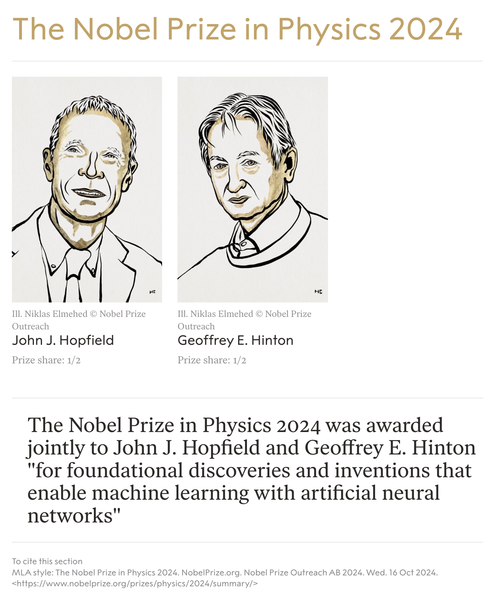
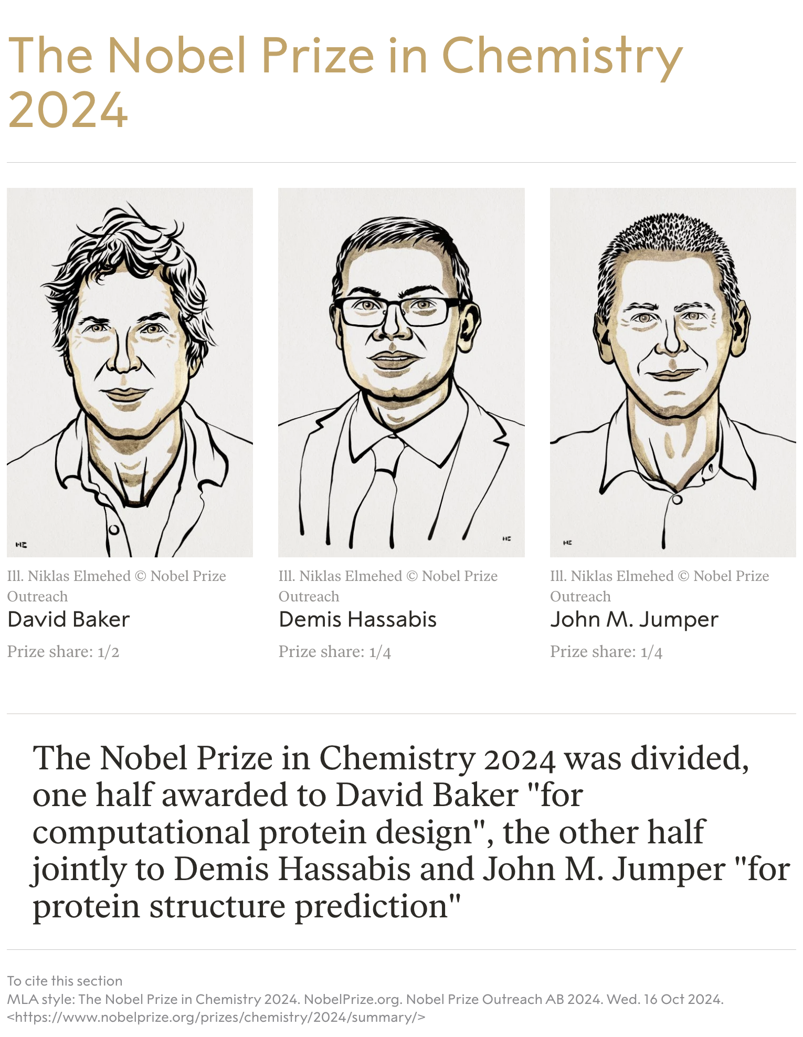

Slide 77

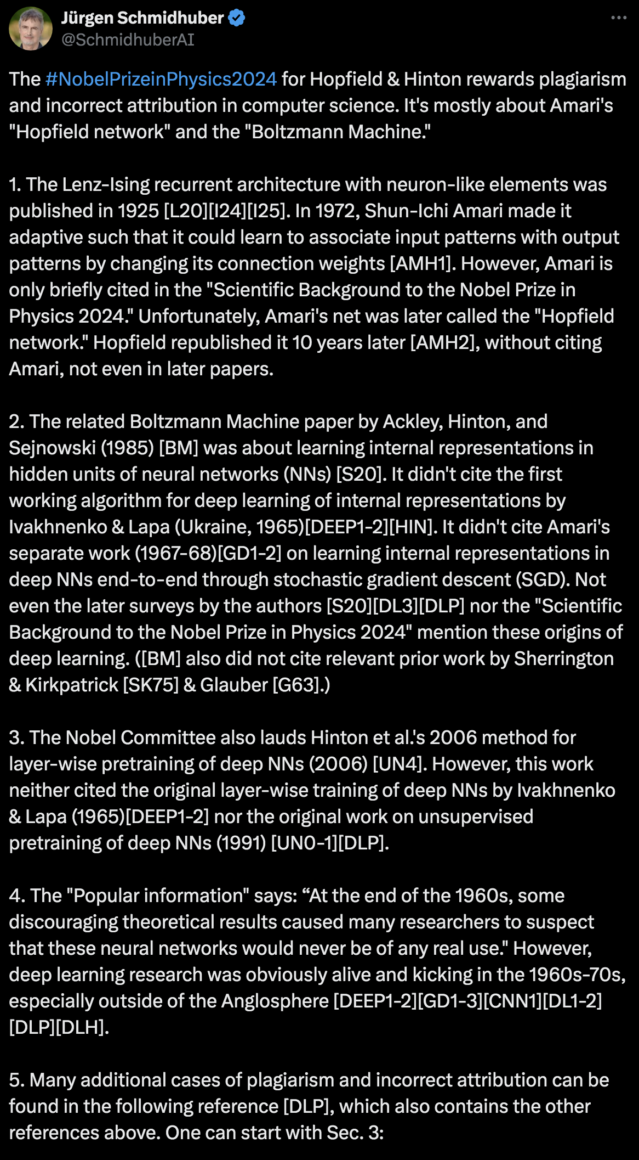
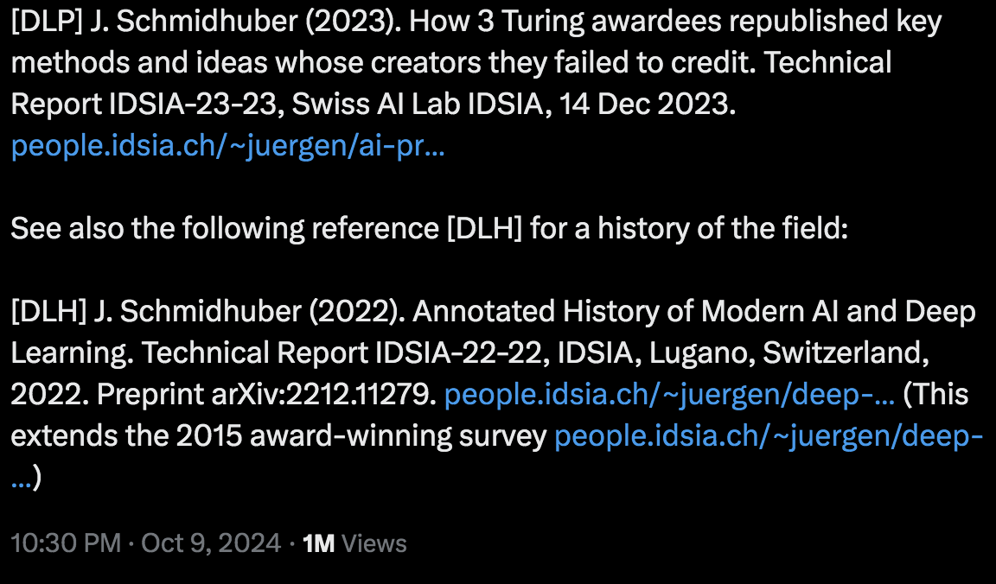
Jurgen’s critics and Geoff’s response
https://x.com/hardmaru/status/1253189802452647936
https://x.com/SchmidhuberAI/status/1844022724328394780

Slide 78
Bi-Direction

Slide 79
Motivation of Bidirection

Slide 81
Bidirectional RNN: simplified diagram

Slide 82
Bidirectional RNN: simplified diagram
The two-way arrows indicate bidirectionality and the depicted hidden states are assumed to be the concatenated forwards+backwards states.

Slide 83
Uni-Direction LSTM
Semi-Supervised Sequence Learning, Google, 2015

Slide 84
Bi-Direction LSTM: ELMo -- Embeddings from Language Models
Peters et al. (2018) Deep Contextual Word Embeddings, NAACL 2018. https://arxiv.org/abs/1802.05365
Learn a deep Bi-NLM and use all its layers in prediction

Slide 85
Bidirectional RNNs
Note: bidirectional RNNs are only applicable if you have access to the entire input sequence.
They are not applicable to Language Modeling, because in LM you only have left context available.
For example, GPT (Generative Pre-trained Transformer) is unidirectional generative model
If you do have entire input sequence (e.g. any kind of encoding), bidirectionality is powerful (you should use it by default).
For example, BERT (Bidirectional Encoder Representations from Transformers) is a powerful pretrained contextual representation system built on bidirectionality.

Slide 86
History note
In 2013-2015, LSTMs started achieving state-of-the-art results
Successful tasks include: handwriting recognition, speech
recognition, machine translation, parsing, image captioning
LSTM became the dominant approach
Now (2019), other approaches (e.g. Transformers) have become more dominant for certain tasks.
For example in WMT (a MT conference + competition):
In WMT 2016, the summary report contains ”RNN” 44 times
In WMT 2018, the report contains “RNN” 9 times and “Transformer” 63 times
Source: "Findings of the 2016 Conference on Machine Translation (WMT16)", Bojar et al. 2016, http://www.statmt.org/wmt16/pdf/W16-2301.pdf
Source: "Findings of the 2018 Conference on Machine Translation (WMT18)", Bojar et al. 2018, http://www.statmt.org/wmt18/pdf/WMT028.pdf

Slide 87
Neural Machine Translation
Machine Translation using Neural Networks

Slide 88
Neural Machine Translation (NMT)

Slide 89
Sequence-to-sequence is versatile!
Sequence-to-sequence is useful for more than just MT
Many NLP tasks can be phrased as sequence-to-sequence:
Summarization (long text → short text)
Dialogue (previous utterances → next utterance)
Parsing (input text → output parse as sequence)
Code generation (natural language → Python code)

Slide 90
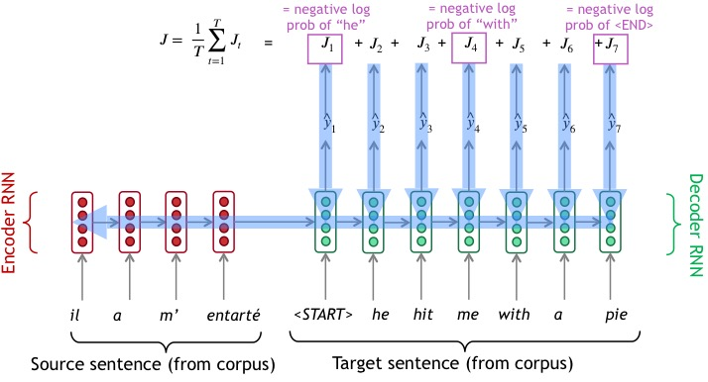
Training a NMT system by BP

Slide 91
Greedy Decoding
We generate (or “decode”) the target sentence by taking argmax on each step of the decoder, called greedy decoding (take most probable word on each step)
It may not correct once wrong decisions are made

Slide 92
Beam Search Decoding
Core idea: On each step of decoder, keep track of the k most probable partial translations (which we call hypotheses)
k is the beam size (in practice around 5 to 10)
A hypothesis (y(1),…,y(t)) has a score which is its log probability:
Scores are all negative, and higher score is better
We search for high-scoring hypotheses, tracking top k on each step
Beam search is not guaranteed to find optimal solution
But much more efficient than exhaustive search!

Slide 93
Beam search decoding example:

Slide 94
Sequence-to-sequence: the bottleneck problem

Slide 95
Attention Mechanism
The idea was originally coined in computer vision, then to NLP.
Dzmitry Bahdanau, Kyunghyun Cho, Yoshua Bengio. Neural Machine Translation by Jointly Learning to Align and Translate. ICLR 2015. arXiv:1409.0473

Slide 96
Sequence-to-sequence with attention

Slide 103
Attention in Equations

Slide 104
Motivation of Transformer

Slide 105
Transformer
“Attention is all you need”

Slide 106
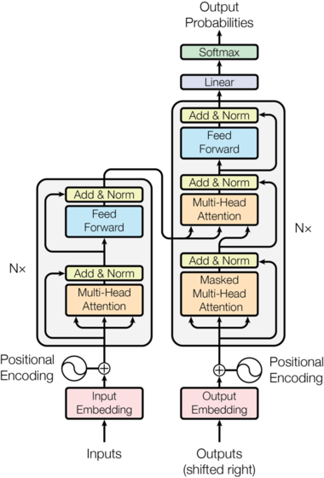
Transformer (Vaswani et al. 2017) “Attention is all you need”
https://arxiv.org/pdf/1706.03762.pdf
Non-recurrent sequence-to-sequence model
A deep model with a sequence of attention-based transformer blocks
Depth allows a certain amount of lateral information transfer in understanding sentences, in slightly unclear ways
Final cost/error function is standard cross-entropy error on top of a softmax classifier
Initially built for NMT:
Task: machine translation with parallel corpus
Predict each translated word

Slide 107
Transformer Pytorch Notebook
Learning about transformers on your own?
Key recommended resource:
http://nlp.seas.harvard.edu/2018/04/03/attention.html
The Annotated Transformer by Sasha Rush, a Jupyter Notebook using PyTorch that explains everything!
https://jalammar.github.io/illustrated-transformer/
Illustrated Transformer by Jay Alammar, a Cartoon about Transformer with attention visualization notebook based on Tensor2Tensor.

Slide 108


Encoder-Decoder Blocks
Encoder-Decoder
N=6 layers

Slide 109
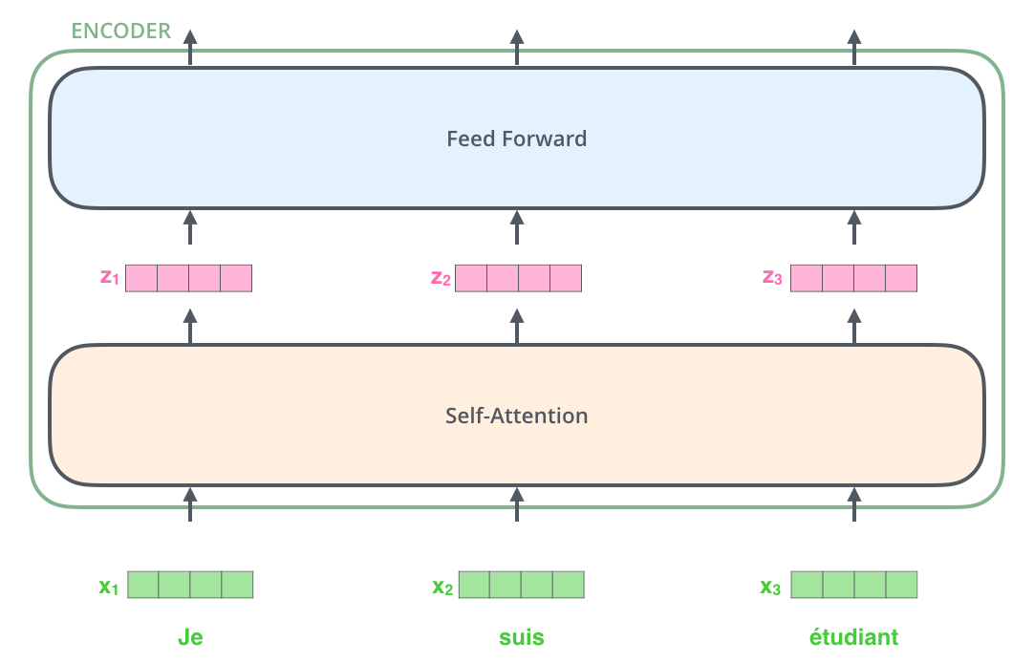
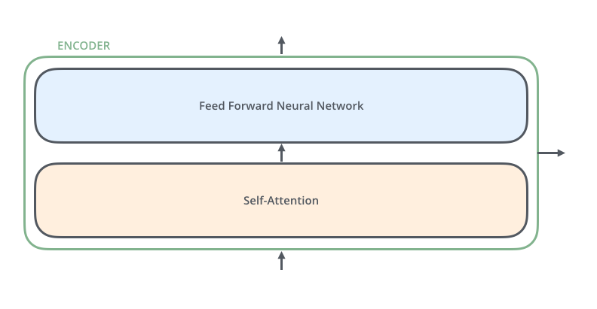
Encoder has two layers
Self-Attention + FeedForward

Slide 110


Attention Illustration
Embedding->(q,k,v)
Dot-Product Attention

Slide 111
Dot-Product Self-Attention: Definition
Inputs: a query q and a set of key-value (k-v) pairs, to an output
Query, keys, values, and output are all vectors
Output is weighted sum of values, where
Weight of each value is computed by an inner product of query and corresponding key
Queries and keys have same dimensionality d_{k}, value have d_{v}

Slide 112
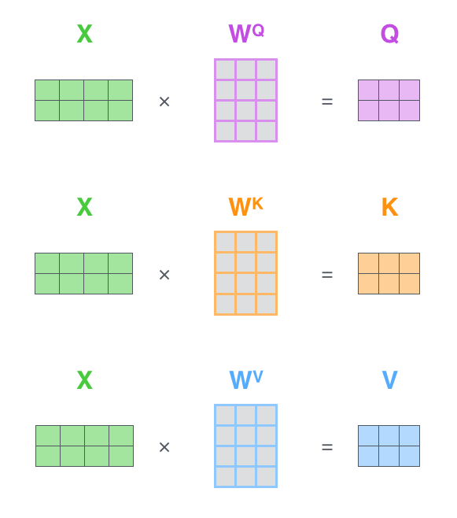

Attention: Multiple Inputs
Matrix input
Scaled dot-product

Slide 113
Dot-Product Attention: Matrix Form
When we have multiple queries q, we stack them in a matrix Q:

Slide 114
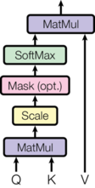
Scaled Dot-Product Attention
Problem: As d_{k} gets large, the variance of q^{T}k increases
some values inside the softmax get large
the softmax gets very peaked
hence its gradient gets smaller.
Solution: Scale by length of query/key vectors:

Slide 115
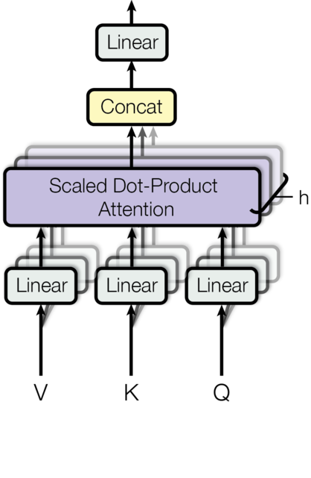
Multi-head Attention
Problem with simple self-attention:
Only one way for words to interact with one-another
Solution: Multi-head attention
First map Q, K, V into h=8 many lower dimensional spaces via W matrices
Then apply attention, then concatenate outputs and pipe through linear layer
Multi-head attention allows the model to jointly attend to information from different representation subspaces at different positions.

Slide 116
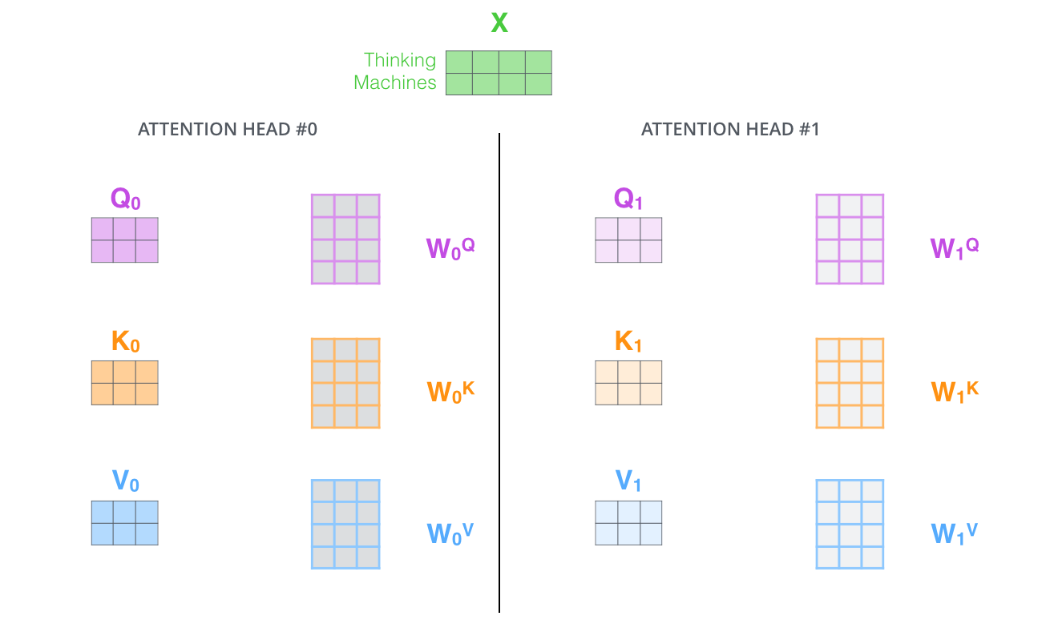
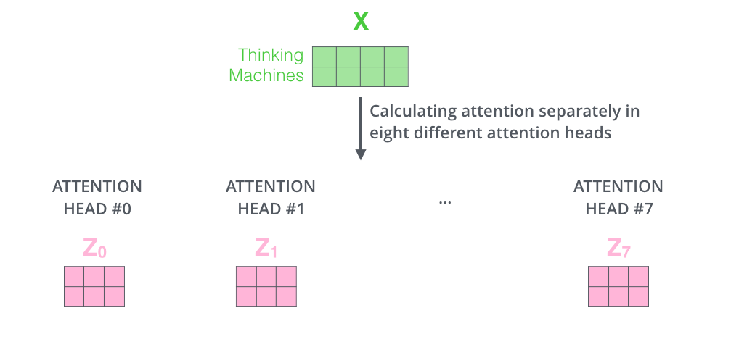
Multihead
2 heads
h=8 heads

Slide 117
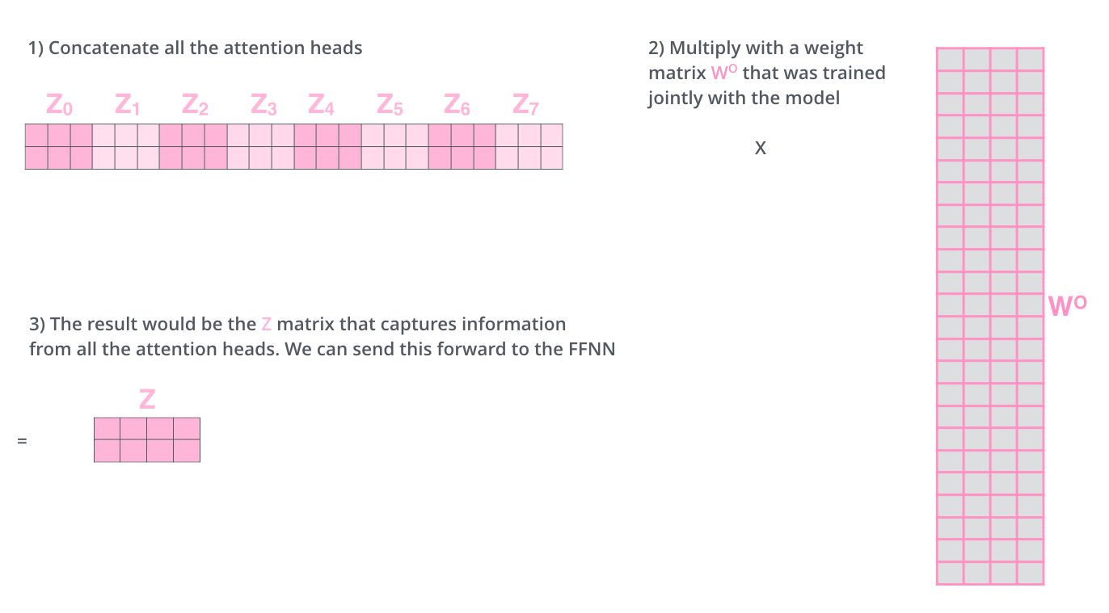
Concatenation
Linear

Slide 118

Multi-head Attention

Slide 119
A Transformer block
Each block has two “sublayers”
Multihead attention
2-layer feed-forward NNet (with ReLU)
Each of these two steps also has:
Residual (short-cut) connection: x+sublayer(x)
LayerNorm(x+sublayer(x)) changes input features to have mean 0, variance 1, and adds two more parameters (Ba et al. 2016)

Slide 120

Residue (Shortcut)

Slide 121
Encoder Input
Actual word representations are word pieces: byte pair encoding
Start with a vocabulary of characters
Most frequent ngram pairs ↦ a new ngram
Example: “es, est” 9 times, “lo” 7 times
Also added is a positional encoding so same words at different locations have different overall representations:
Or learned

Slide 122
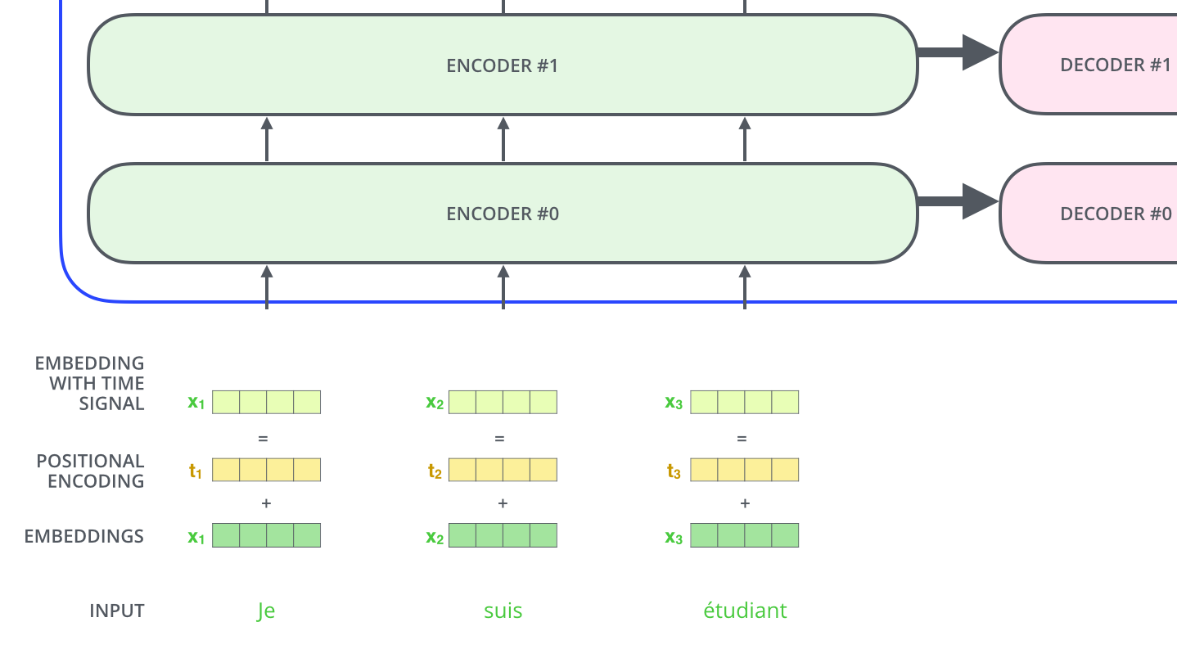
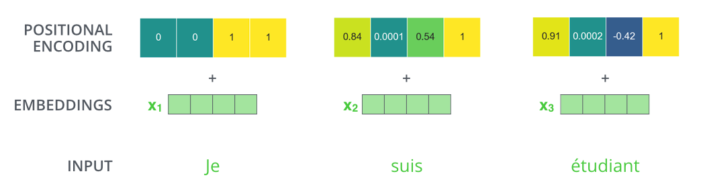

Slide 123
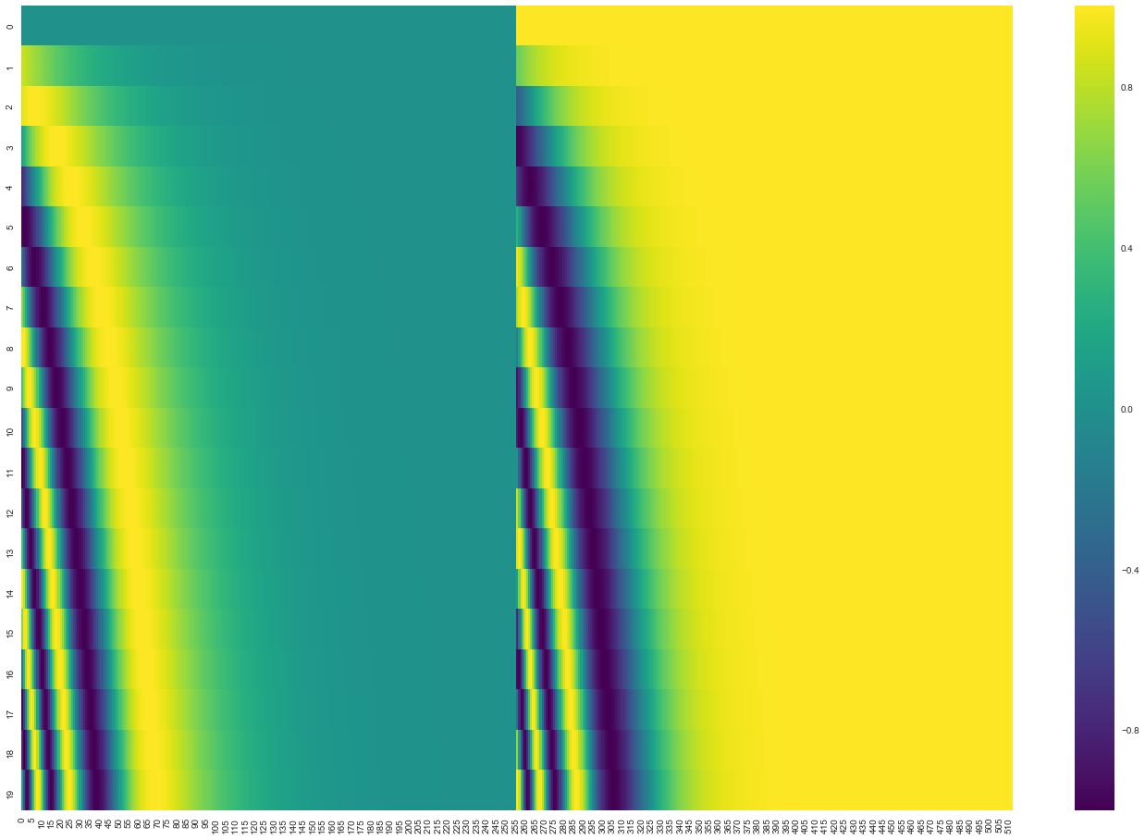
Sin/Cos Position Encoding
Figure. Each row corresponds the a positional encoding of a vector. So the first row would be the vector we’d add to the embedding of the first word in an input sequence. Each row contains 512 values – each with a value between 1 and -1. We’ve color-coded them so the pattern is visible.

Slide 124
Transformer Encoder
Blocks are repeated N=6 or more times

Slide 125
Transformer Decoder
2 sublayer changes in decoder
Masked decoder self-attention on previously generated outputs
Encoder-Decoder Attention, where queries come from previous decoder layer and keys and values come from output of encoder
Blocks repeated N=6 times also

Slide 126


Encoder-Decoder

Slide 127

Illustration of Encoder-Decoder

Slide 128

Illustration of Encoder-Decoder

Slide 129
Thank you!

